Slide 1


VHDL Design of a 1-Bus Processor with a Hardwired Control Unit
Monitored by: Dr. Jalal Khlaifat
Done by:
PUJA KARMAKAR 20194981
WEAAM WAFEEQ OMRAN AJOOR 20196537
ZAINAB REDHA EBRAHIM MATROOK 20195982

Slide 2
TABLE OF CONTENTS
Objectives
01
Introduction to the Process
02
Processor specification and design logic
03
Implementation and Results
04
CONCLUSIONS
05

Slide 3
Objectives
VHDL code to implement 1-bus processor with a hardwired control unit that have specific characteristic.
Simulate each component and test their functionality.
Write a top level code to connect all components as a one system.

Slide 4
INTRODUCTION
A common analogy used for describing a computer's processor (CPU) is thinking of the computer like a human body and the CPU is its brain. The term "Processor" refers to the CPU. The CPU is in charge of processing the computer's tasks by constantly resolving mathematical and logical problems. A computer would have at least one CPU which is usually divided into a Control Unit, Data path, buses, and temporary storage.
Notes:
The control unit (CU) is responsible to organize and fetch the CPU instructions and generating “Control Signals” that control the data path and tell the ALU, memory, and input/output devices what to do.
Control units can be divided into two types: “Microprogrammed based control unit” and “Hardwired based controlled Unit”.
1- Microprogrammed-based control unit treats the relationship between control inputs and outputs as a memory system. Where the memory contains control signals that are stored as “words”. During instruction execution at each clock tick, the required “word” is fetched from memory to supply the control signals.
2- Whereas, Hardwired-based controlled Unit treats the relationship between control inputs and outputs as a series of Boolean functions, one for each control signal.
Data path contains CPU registers and ALU. ALU is in charge of performing arithmetic operations and logical functions.
While the “bus” is an interconnection through which voltage signals will be flowing and the bus can be used for a different purpose. There are three types of bus organization for the data bus One-Bus Organization (only one operand can be fetched from this bus), Two-Bus Organization (two operands can be fetched from this bus, one is used for fetching the register, and one for the ALU), and Three-Bus Organization (three operands can be fetched from this bus). Finally, a temporary storage unit such as register files or latches is used to provide easy access to data within the CPU.

Slide 5
Processor
specification
and Design logic
1-bus processor with hardwired control unit
32 -bit Data Bus
32 -bit Address Bus
32 -bit Program Counter (PC).
32 -bit Instruction Register (IR).
24 general purpose registers.
SRC has 13 different instructions each with different format. Instractions are: Instructions: Add, Or, Sub, And, Addi , Ld, St, Lar, Brlpl, Brlmi, Stop, Nop, Shc. (The Shift Circular instruction execute within one clock cycle)

Slide 6
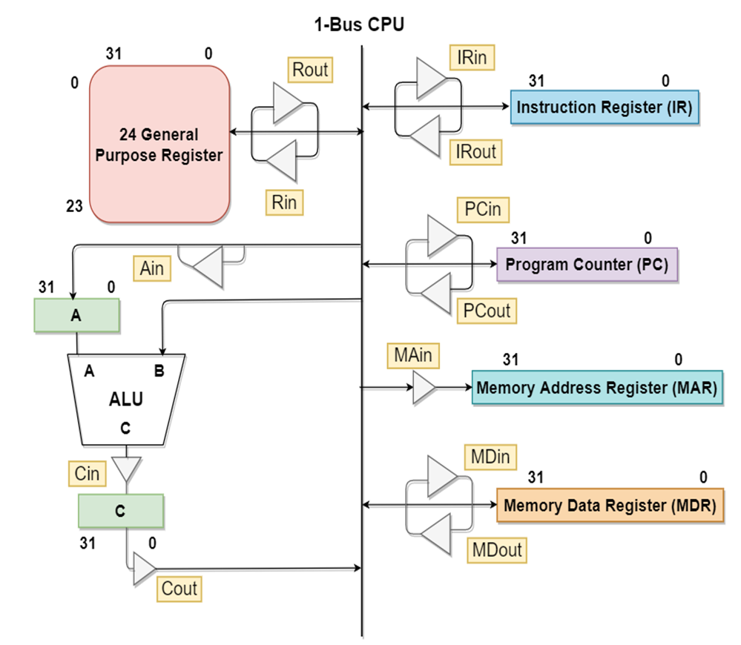
System Block Diagram

Slide 7
ALU Component

Slide 8
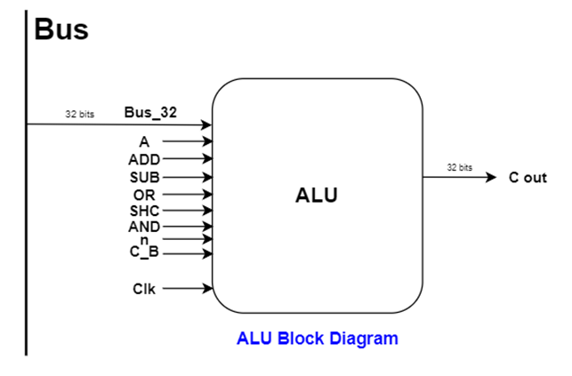
ALU Block Diagram

Slide 9
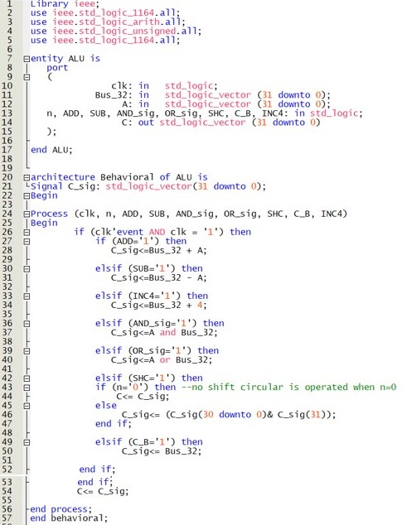
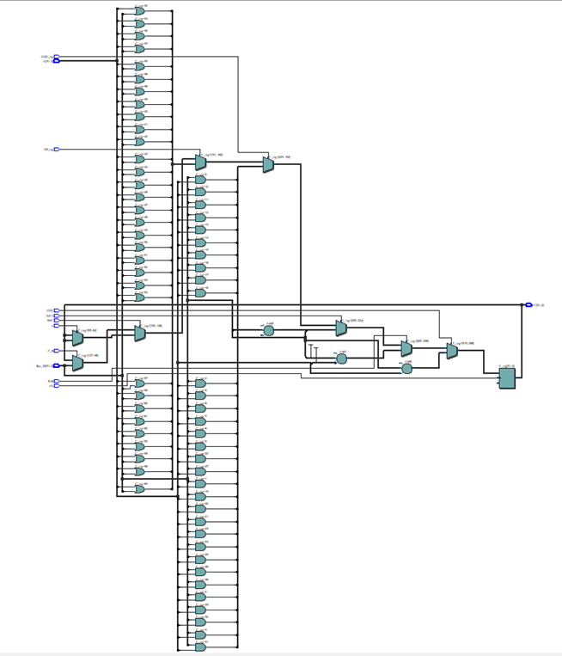
ALU CODE and RTL

Slide 10
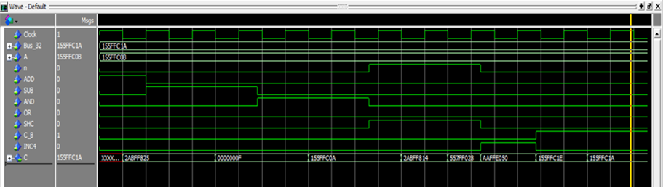
ALU Simulation
The following inputs were initialised :
Bus_32: 00010101 01011111 11111100 00011010 (binary) = 155FFC1A (hexadecimal)
A: 00010101 01011111 11111100 00001011 (binary) = 155FFC0B (hexadecimal)
At 1st clock pulse: (Addition operation)
When ADD=1, we get output C= 2ABFF825 (hexadecimal)
At 2nd clock pulse: (Subtraction operation)
When SUB=1, we get output C= F (hexadecimal)
At 3rd clock pulse: (AND operation)
When AND=1, we get output C= 155FFC0A (hexadecimal)

Slide 11
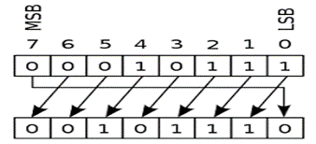
ALU Simulation
In case of Shift Circular operation:
When SHC=1, n=1 (at each clock pulse the LSB from the existing output shifts in the below manner)
Before 4th clock pulse: = 155FFC0A (hexadecimal)
After 4th clock pulse: = 2ABFF814 (hexadecimal)
After 5th clock pulse: = 557FF028 (hexadecimal)
After 6th clock pulse: = AAFFE050 (hexadecimal)
At 7th clock pulse: (INC4 operation)
When INC4=1, we get output C= = 155FFC1E (hexadecimal)
At 8th clock pulse: (C_B operation)
When C_B =1, we get output C= 155FFC1A (hexadecimal)

Slide 12
Memory Component

Slide 13
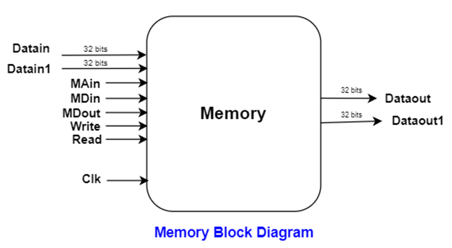
Memory Block Diagram

Slide 14
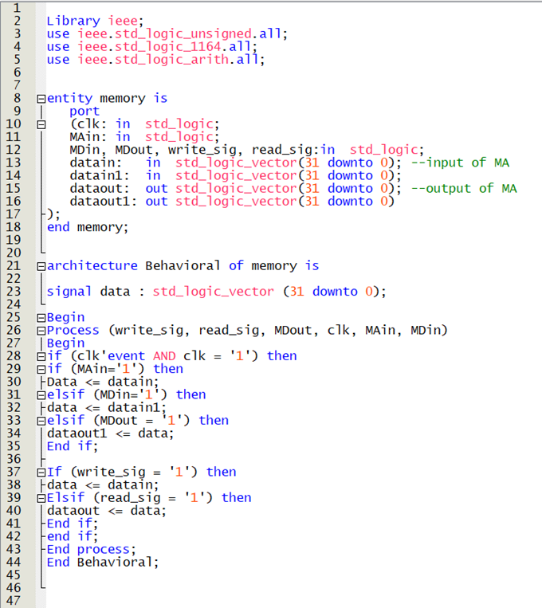
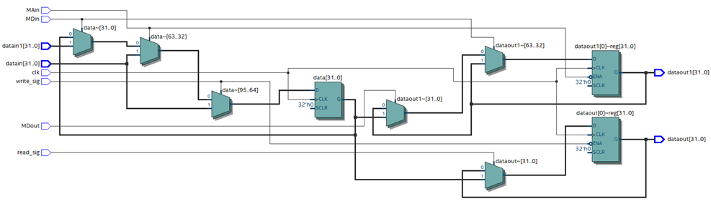
Memory CODE and RTL

Slide 15
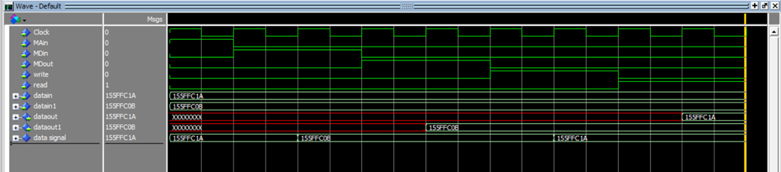
Memory Simulation
The following inputs were initialised:
Datain: 155FFC1A (hexadecimal)
Datain1: 155FFC0B (hexadecimal)
At rising edge of clock when Main=1, we get data signal = 155FFC1A (hexadecimal)
When MDin=1, we get data signal = 155FFC0B (hexadecimal)
When MDout=1, we get Dataout1 = 155FFC0B (previously saved as data signal)
When Write=1, we get data signal = Datain = 155FFC1A (hexadecimal)
When Read=1, we get Dataout = 155FFC1A (hexadecimal) (previously inputted using write signal)

Slide 16
Register File Component

Slide 17
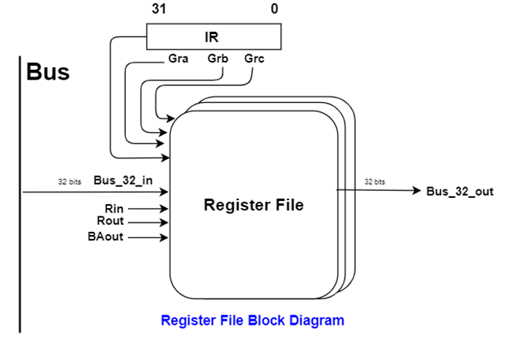
Register File Block Diagram

Slide 18
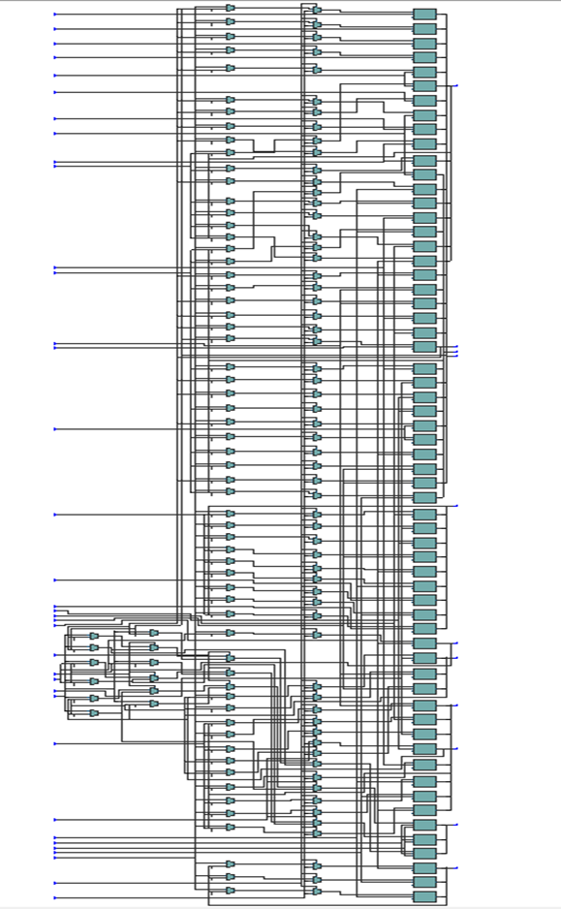
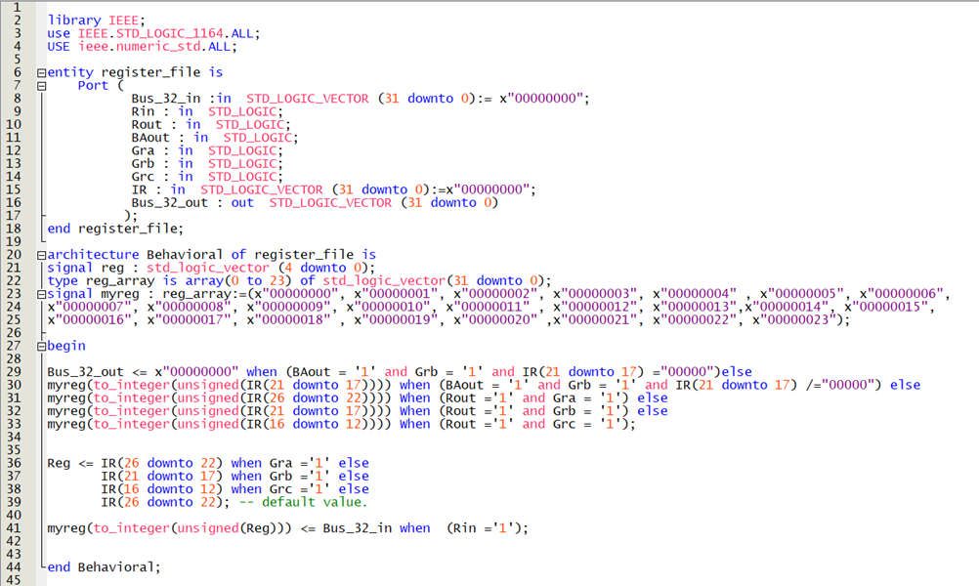
Register File CODE and RTL

Slide 19
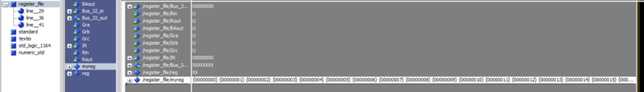
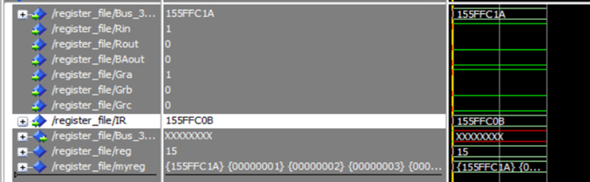
Register File Simulation
The beginning phase when we can see the signal initialised for the 24 General Purpose Registers
The following inputs were initialised:
Bus_32_in: 00010101 01011111 11111100 00011010 (binary) = 155FFC1A (hexadecimal)
IR: 00010101 01011111 11111100 00001011 (binary) = 155FFC0B (hexadecimal)
When Rin=1, Gra=1, we save the value of the (Bus_32_in) input to one of the register signals

Slide 20
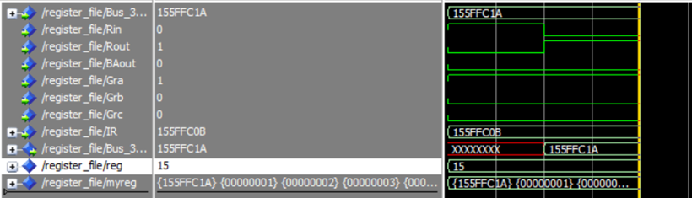
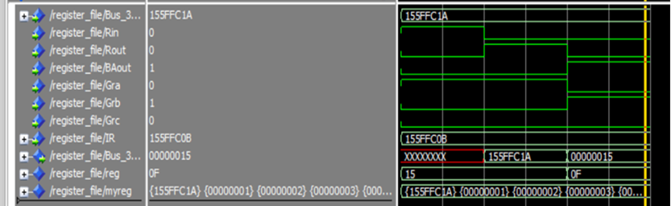
Register File Simulation
When Rout=1, Gra=1, we get the value saved in the register as (Bus_32_out) output
When BAout=1, Grb=1 we get the value from IR(21 downto 17)= 01111 (binary)= 15 (decimal) as output for (Bus_32_out)

Slide 21
Control Unit Component

Slide 22
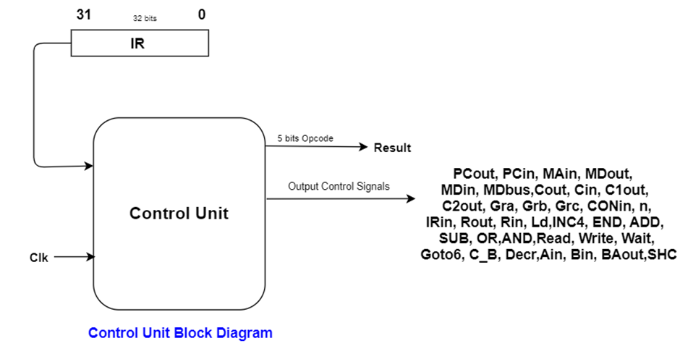
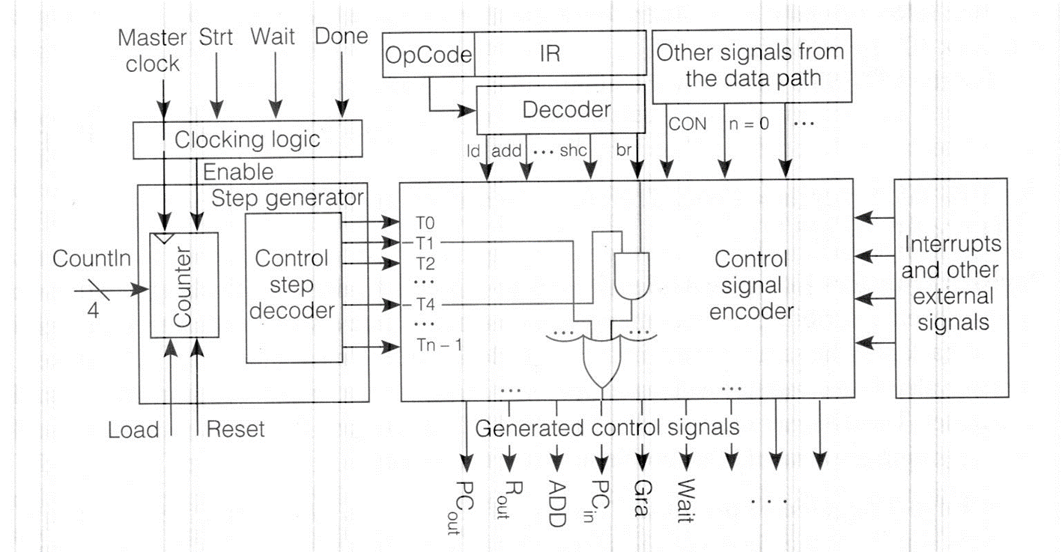
Control Unit Block Diagram

Slide 23
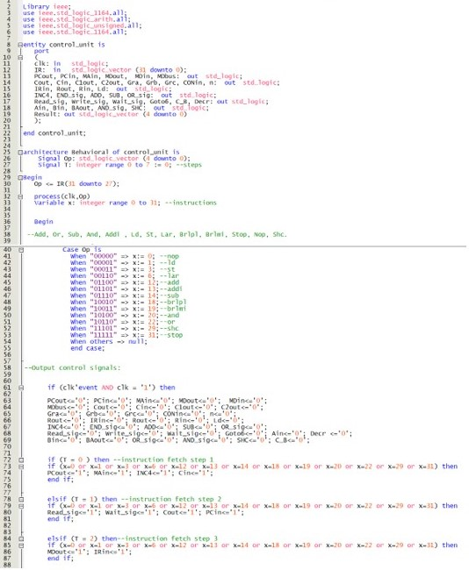
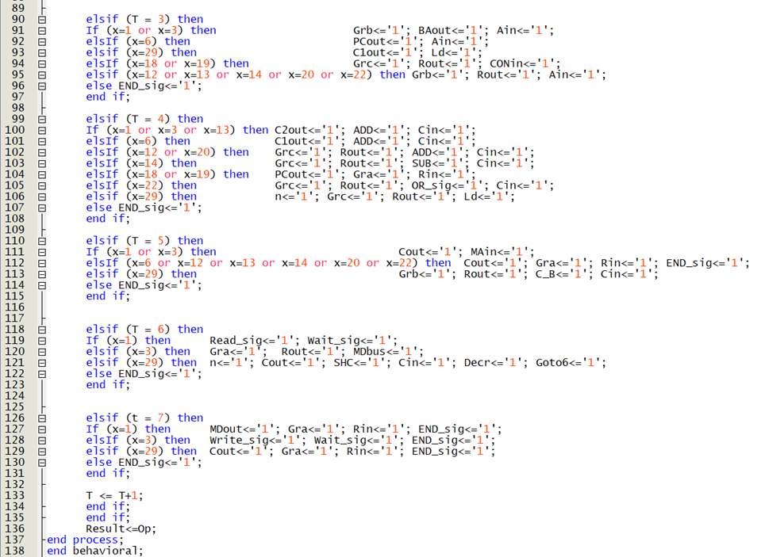
Control Unit CODE and RTL

Slide 24
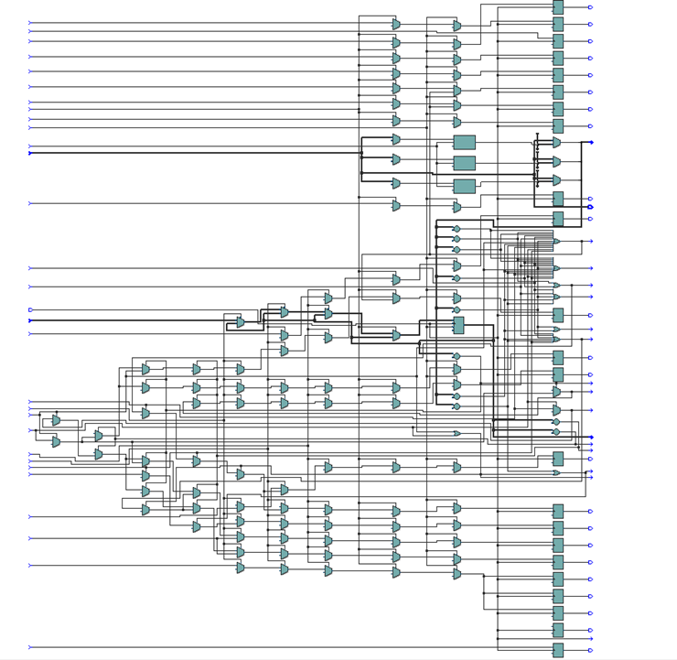

Control Unit CODE and RTL

Slide 25
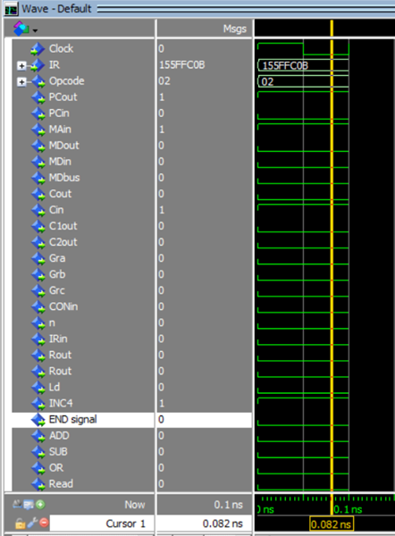
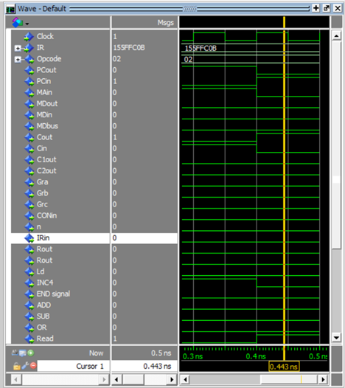
Control Unit Simulation
We initialised the following input:
IR: 00010101 01011111 11111100 00001011 (binary) = 155FFC0B (hexadecimal)
We get outputs PCout=1, Main=1, INC4=1, Cin=1, Opcode=2 (decimal) and initially step T=0 (instruction fetch
To verify the simulation, we manually initialised step T=1 (instruction fetch step 2) to match with control unit outputs Read=1, Wait=1, Cout=1, PCin=1, Opcode=2 (decimal)

Slide 26
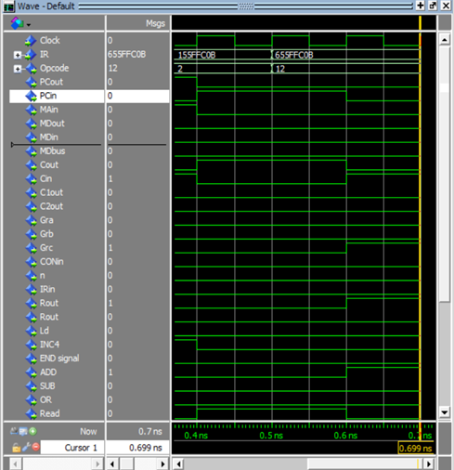
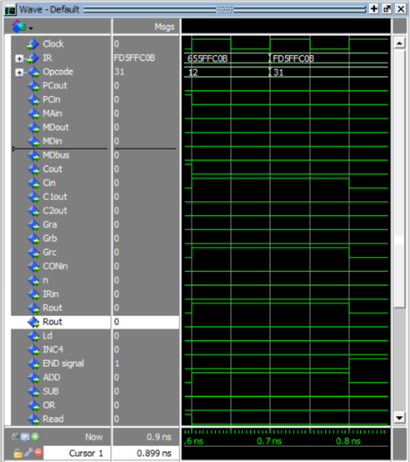
Control Unit Simulation
We initialised an input where IR: 01100101 01011111 11111100 00001011 (binary) = 655FFC0B (hexadecimal)
We get outputs Grc=1, Rout=1, ADD=1, Cin=1, Opcode=12 (decimal) which is ADD operation and set the step T=4 to verify the simulation.
We initialised an input where IR: FD5FFC0B (hexadecimal)
We get all outputs zero other than End_signal=1, Opcode=31 (decimal) which is STOP operation and set the step T=4 to verify the simulation.

Slide 27
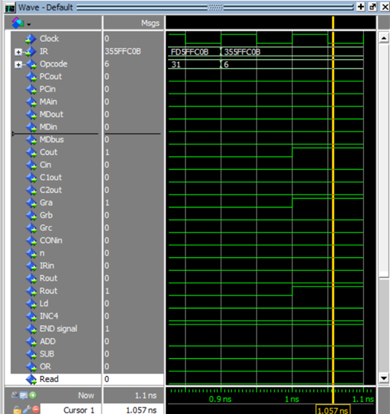
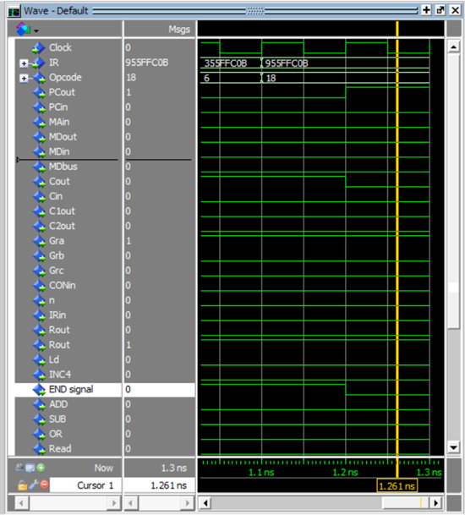
Control Unit Simulation
We initialised an input where IR: 355FFC0B (hexadecimal)
We get as outputs Cout=1, Gra=1, Rin=1, END_signal=1, Opcode=6 (decimal) which is LAR operation and set the step T=5 to verify the simulation.
We initialised an input where IR: 955FFC0B (hexadecimal)
We get as outputs PCout=1, Gra=1, Rin=1, Opcode=18 (decimal) which is brlpl operation and set the step T=4 to verify the simulation.

Slide 28
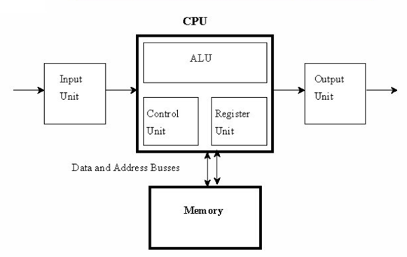
Datapath Block Diagram

Slide 29
Datapath Component

Slide 30
CONCLUSIONS
The objective of this project have been achieved by implementing implement 1-bus processor with a hardwired control unit that have specific characteristic using VHDL Code. Also, the components’ functionality was tested by running the RTL Viewer and simulate each component. Furthermore, we have tried to connect all components as a one system.
Notes:
By achieving these goals, the team members have learnt:
-The importance of RTN Concrete (Control Signals)within the CPU.
-Learnt how to program all the components and debug errors.
-Understand how all the components are connected to reach other and how we program the top level.
-Main program syntax was learnt for example, during the use of “while” condition the ‘process’ is not required.

Slide 31
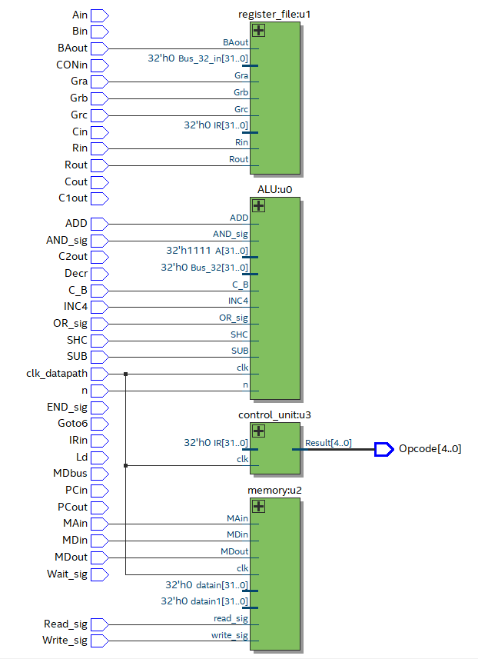
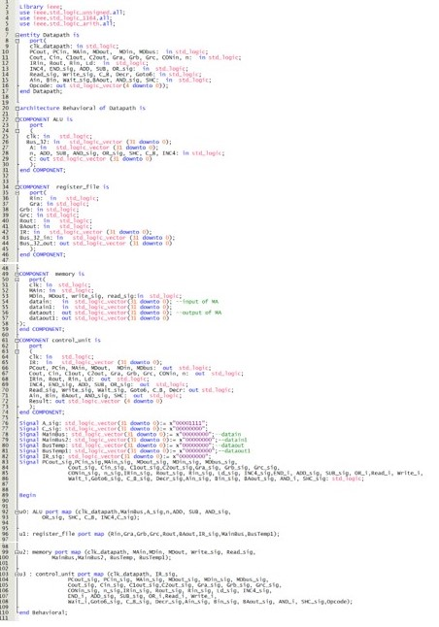
Datapath CODE and RTL

Slide 32
Thank You !

